Slide 1
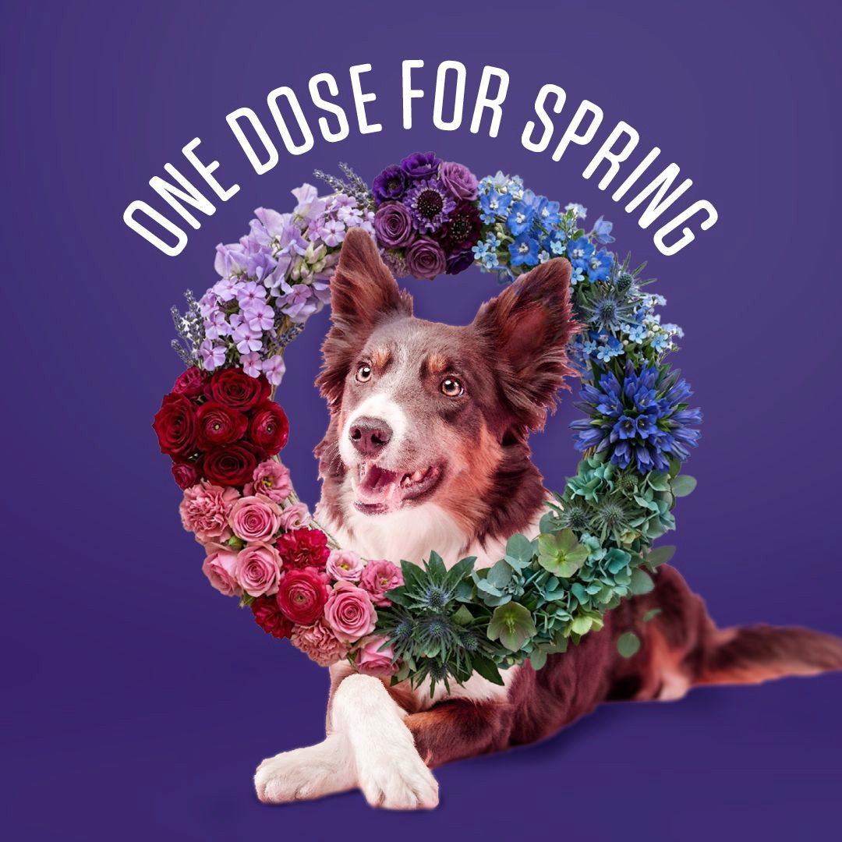
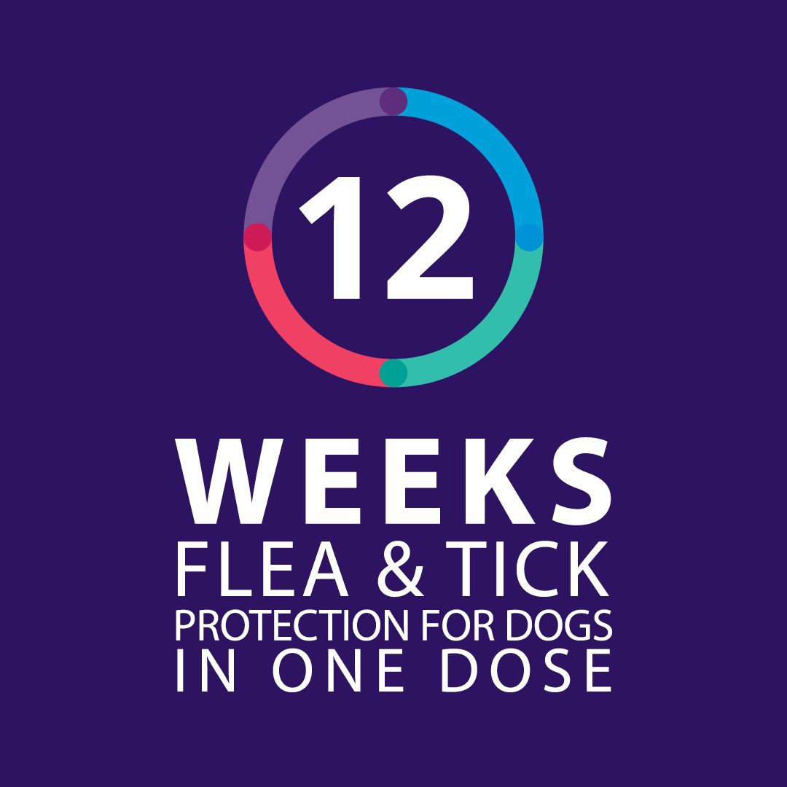
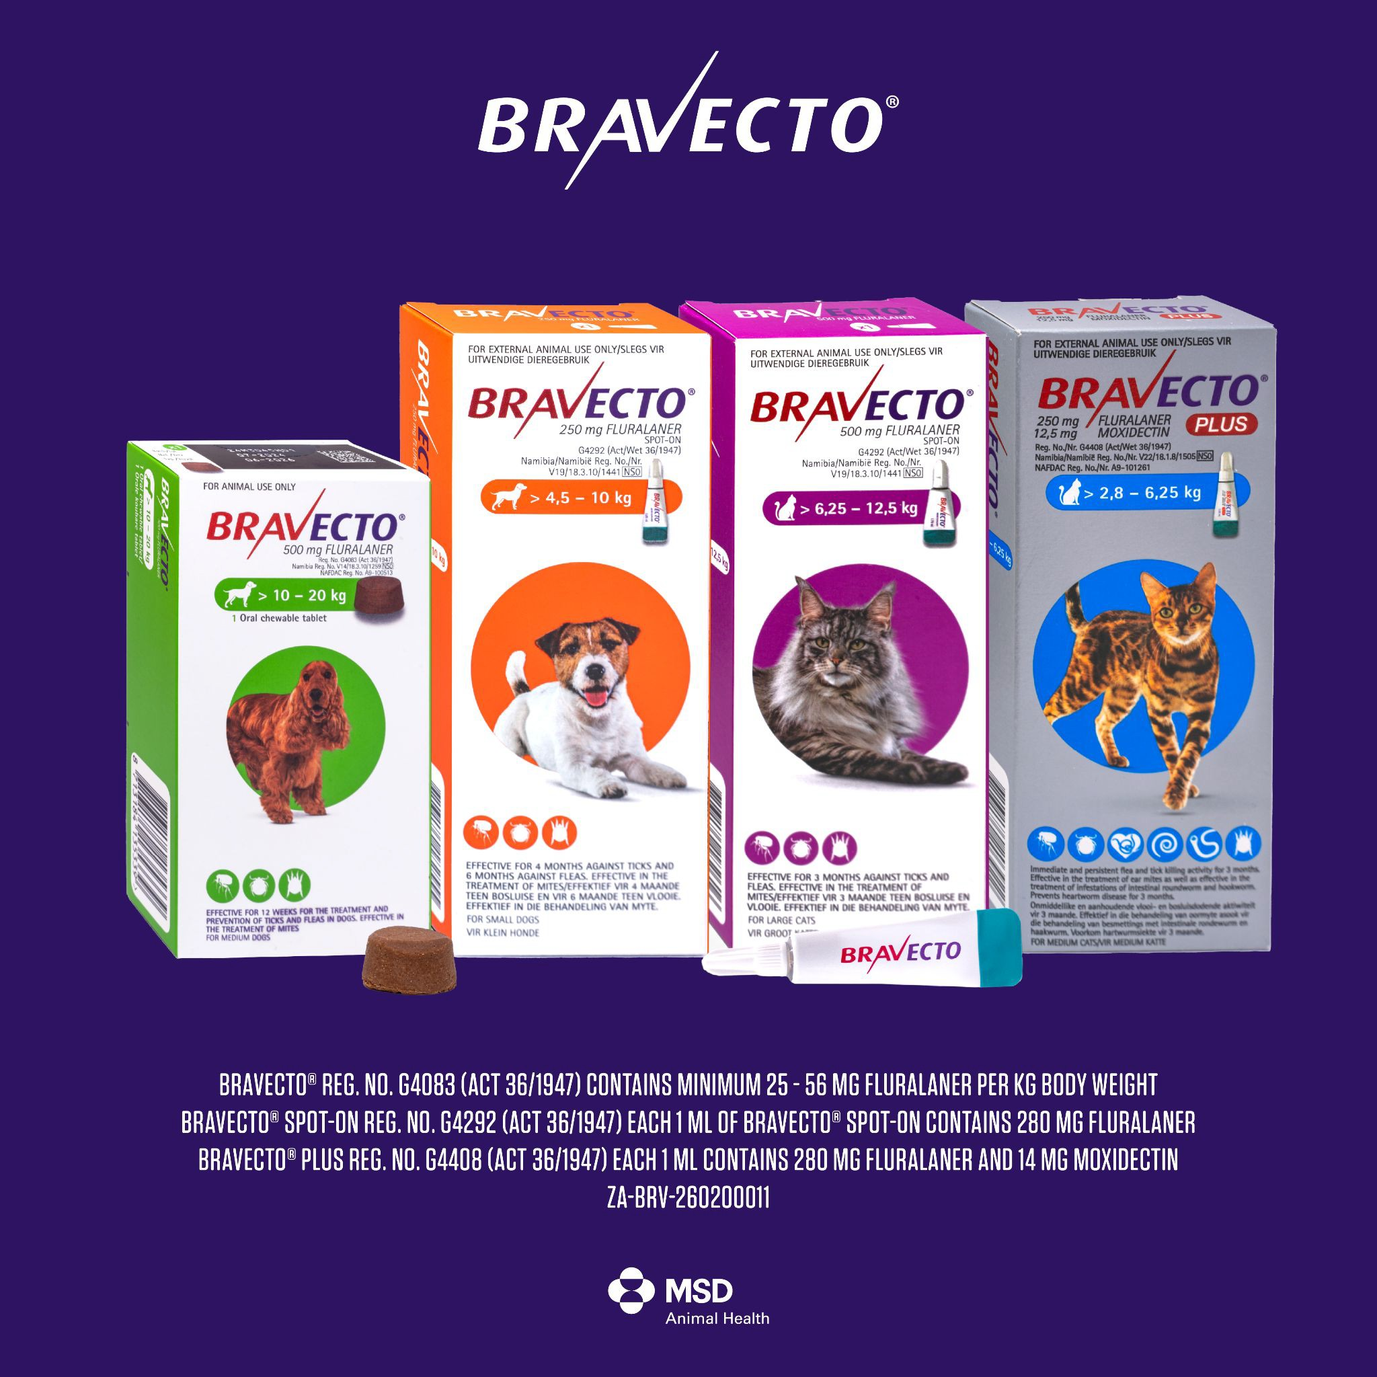

Spring Promotion 2026 | Meta Assets: Carousel - Combined product carousel
Bravecto®
[Button link: https://www.bravecto.co.za/ﬂea-and-tick/]
Spring means more sunshine and more time together. Keep your pets protected all season with Bravecto®’s fast-acting, long-lasting protection against ticks and ﬂeas. Available from your nearest vet.
#BravectoSA #OneDoseforSpring
Long lasting protection against ticks & ﬂeas
Long lasting protection against ticks & ﬂeas
Long lasting protection against ticks & ﬂeas
Get it at vets, speciality pet shops & online

Slide 2
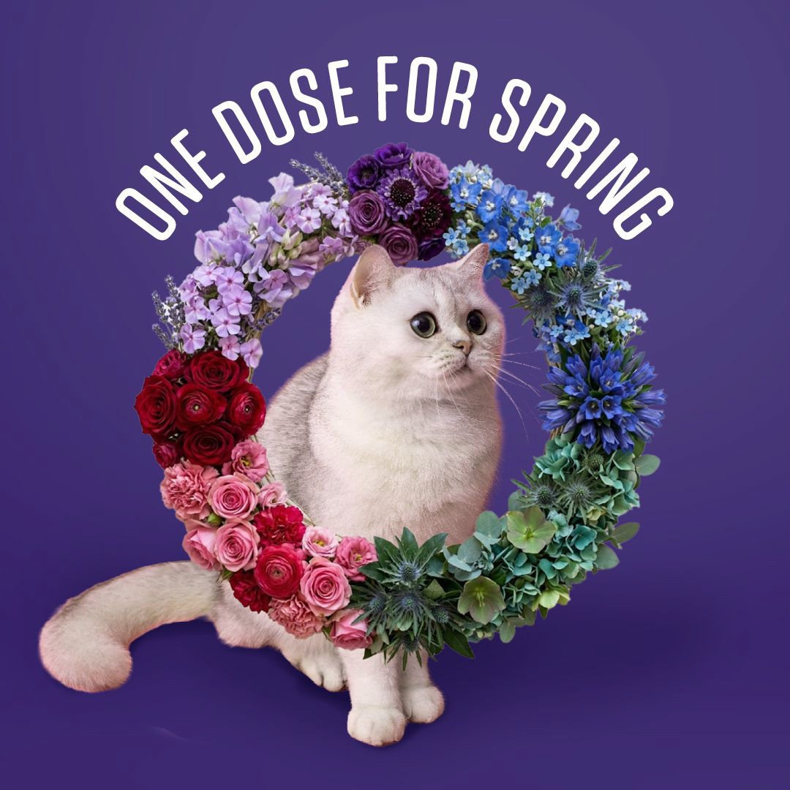
Spring Promotion 2026 | Meta Assets: Carousel - Combined product carousel
Bravecto®
[Button link: https://www.bravecto.co.za/ﬂea-and-tick/]
Spring is in the air! Keep your pets protected all season with Bravecto®’s fast-acting, long-lasting protection against ticks and ﬂeas. Available from your nearest vet.
#BravectoSA #OneDoseforSpring
Long lasting protection against ticks & ﬂeas
Long lasting protection against ticks & ﬂeas
Long lasting protection against ticks & ﬂeas
Get it at vets, speciality pet shops & online

Slide 3
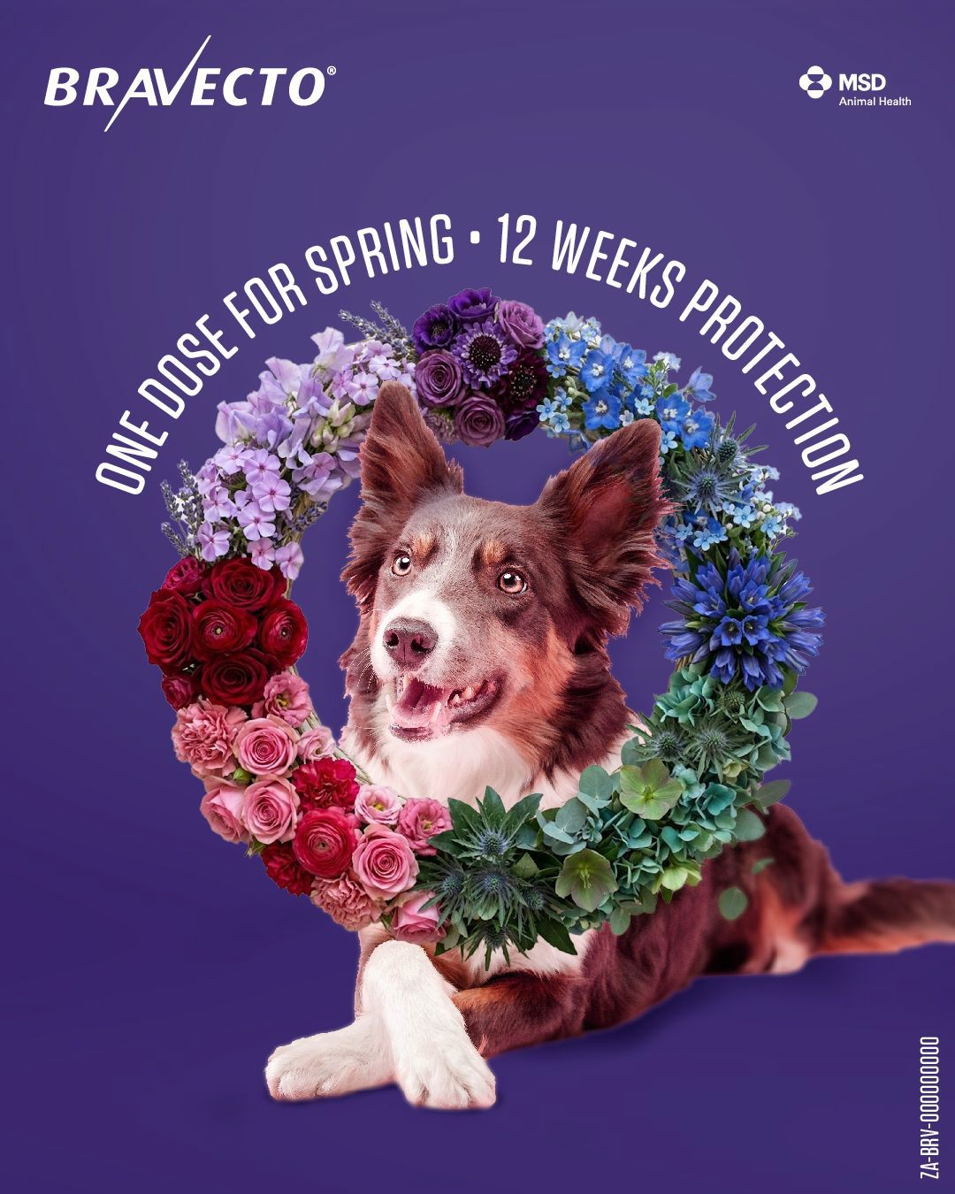
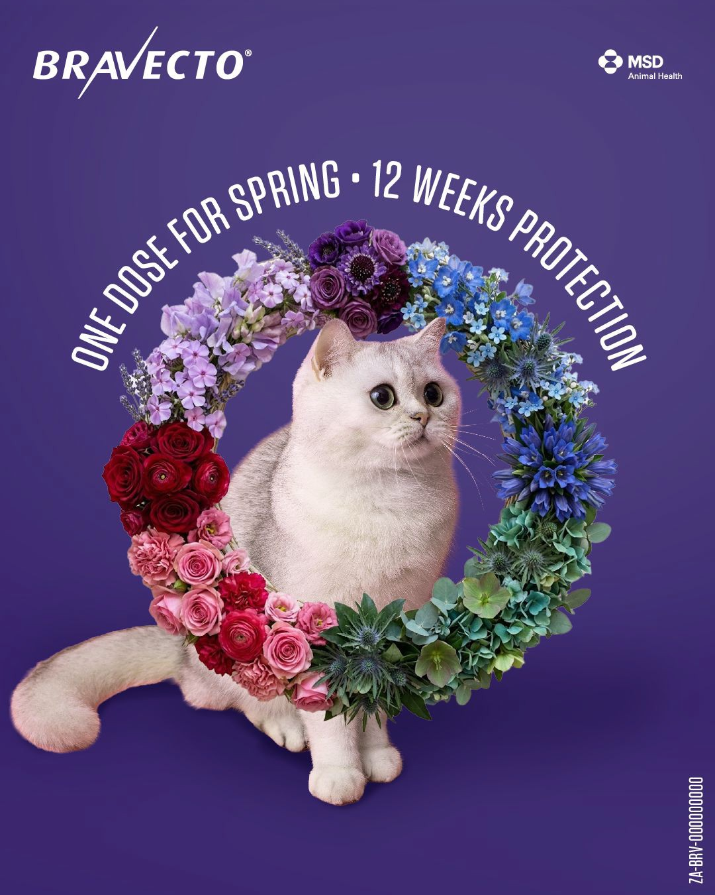
Spring Promotion 2026 | Meta Assets: Image Ads
Bravecto®
[Button link: https://www.bravecto.co.za/for-dogs/]
[Button link: https://www.bravecto.co.za/for-cats/]
Spring is in the air and adventure awaits! But those pesky ticks and ﬂeas are also getting ready… Keep your dog protected all season with Bravecto®. One dose gives you peace of mind that they’re protected against ticks and ﬂeas for
12 weeks.
#BravectoSA #OneDoseforSpring
The birds are chirping. The ﬂowers are blooming. But while your cat is busy plotting world domination from the window sill, so are those pesky ticks and ﬂeas!
Keep your cat protected all season with Bravecto®. One dose gives you peace of mind that they’re protected against ticks and ﬂeas for 3 months.
#BravectoSA #OneDoseforSpring

Slide 4
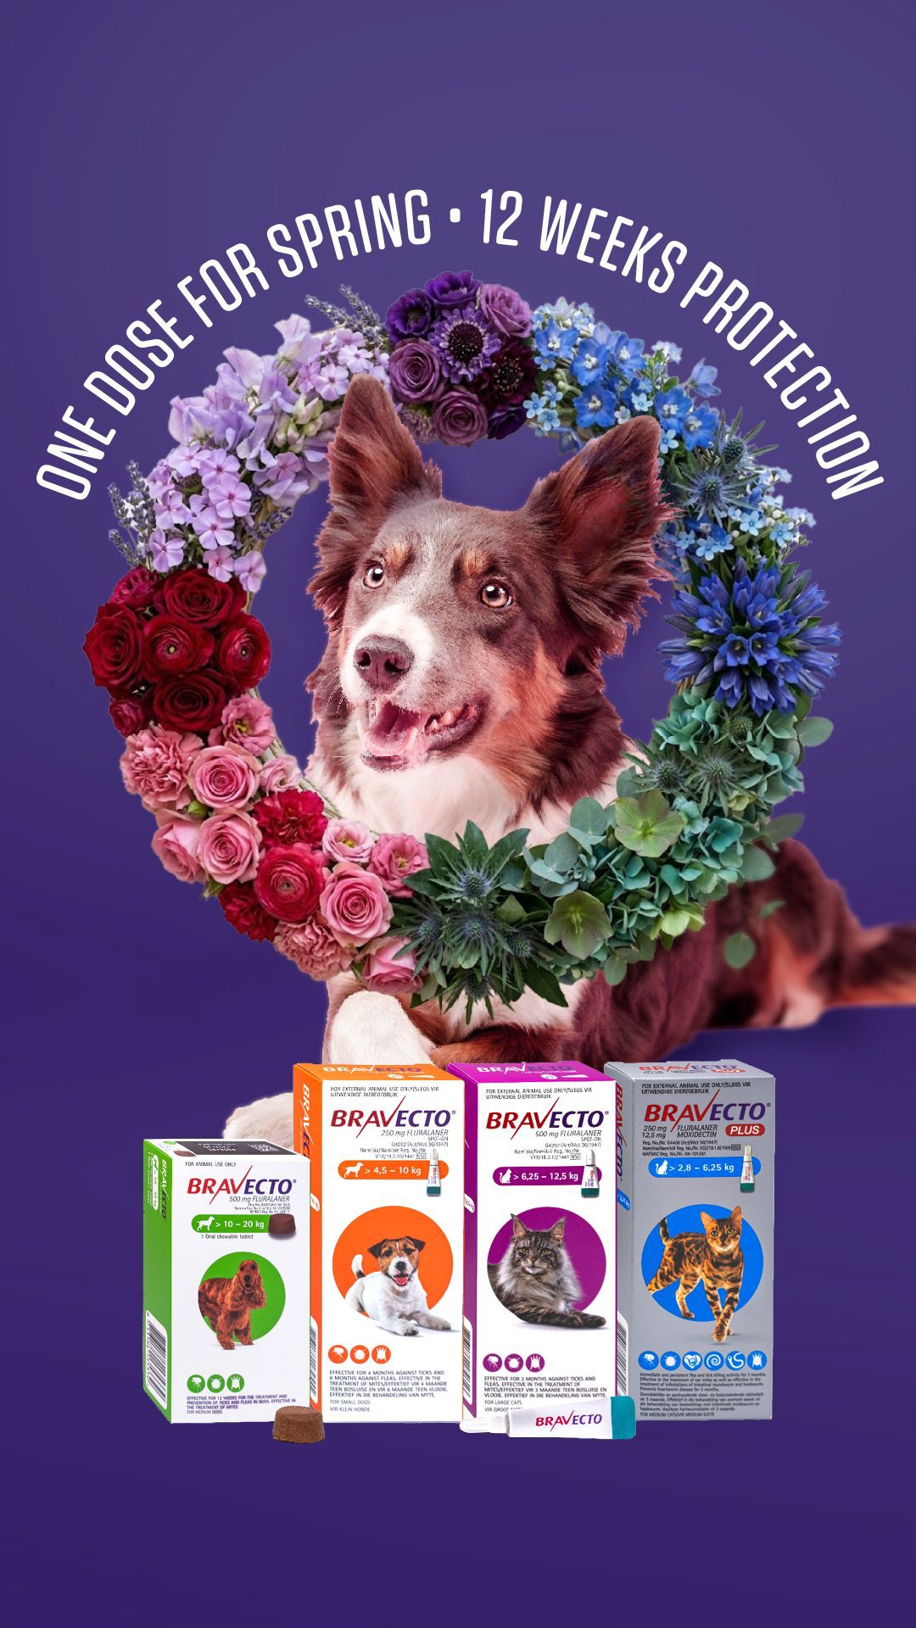
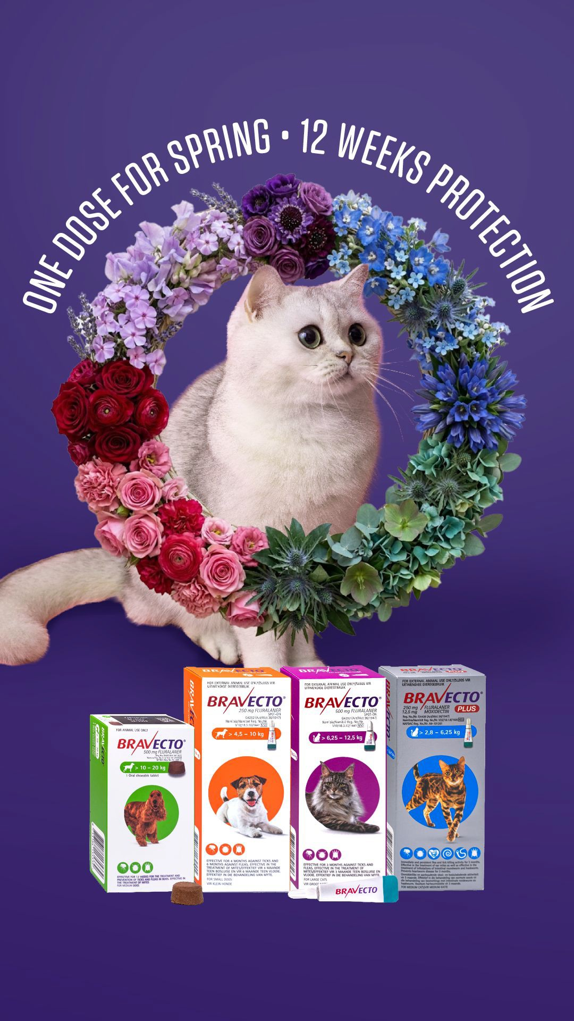
Spring Promotion 2026 | Meta Assets: Stories (Static)
Bravecto®

Slide 5

Spring Promotion 2026 | Facebook Cover
Bravecto®

Slide 6
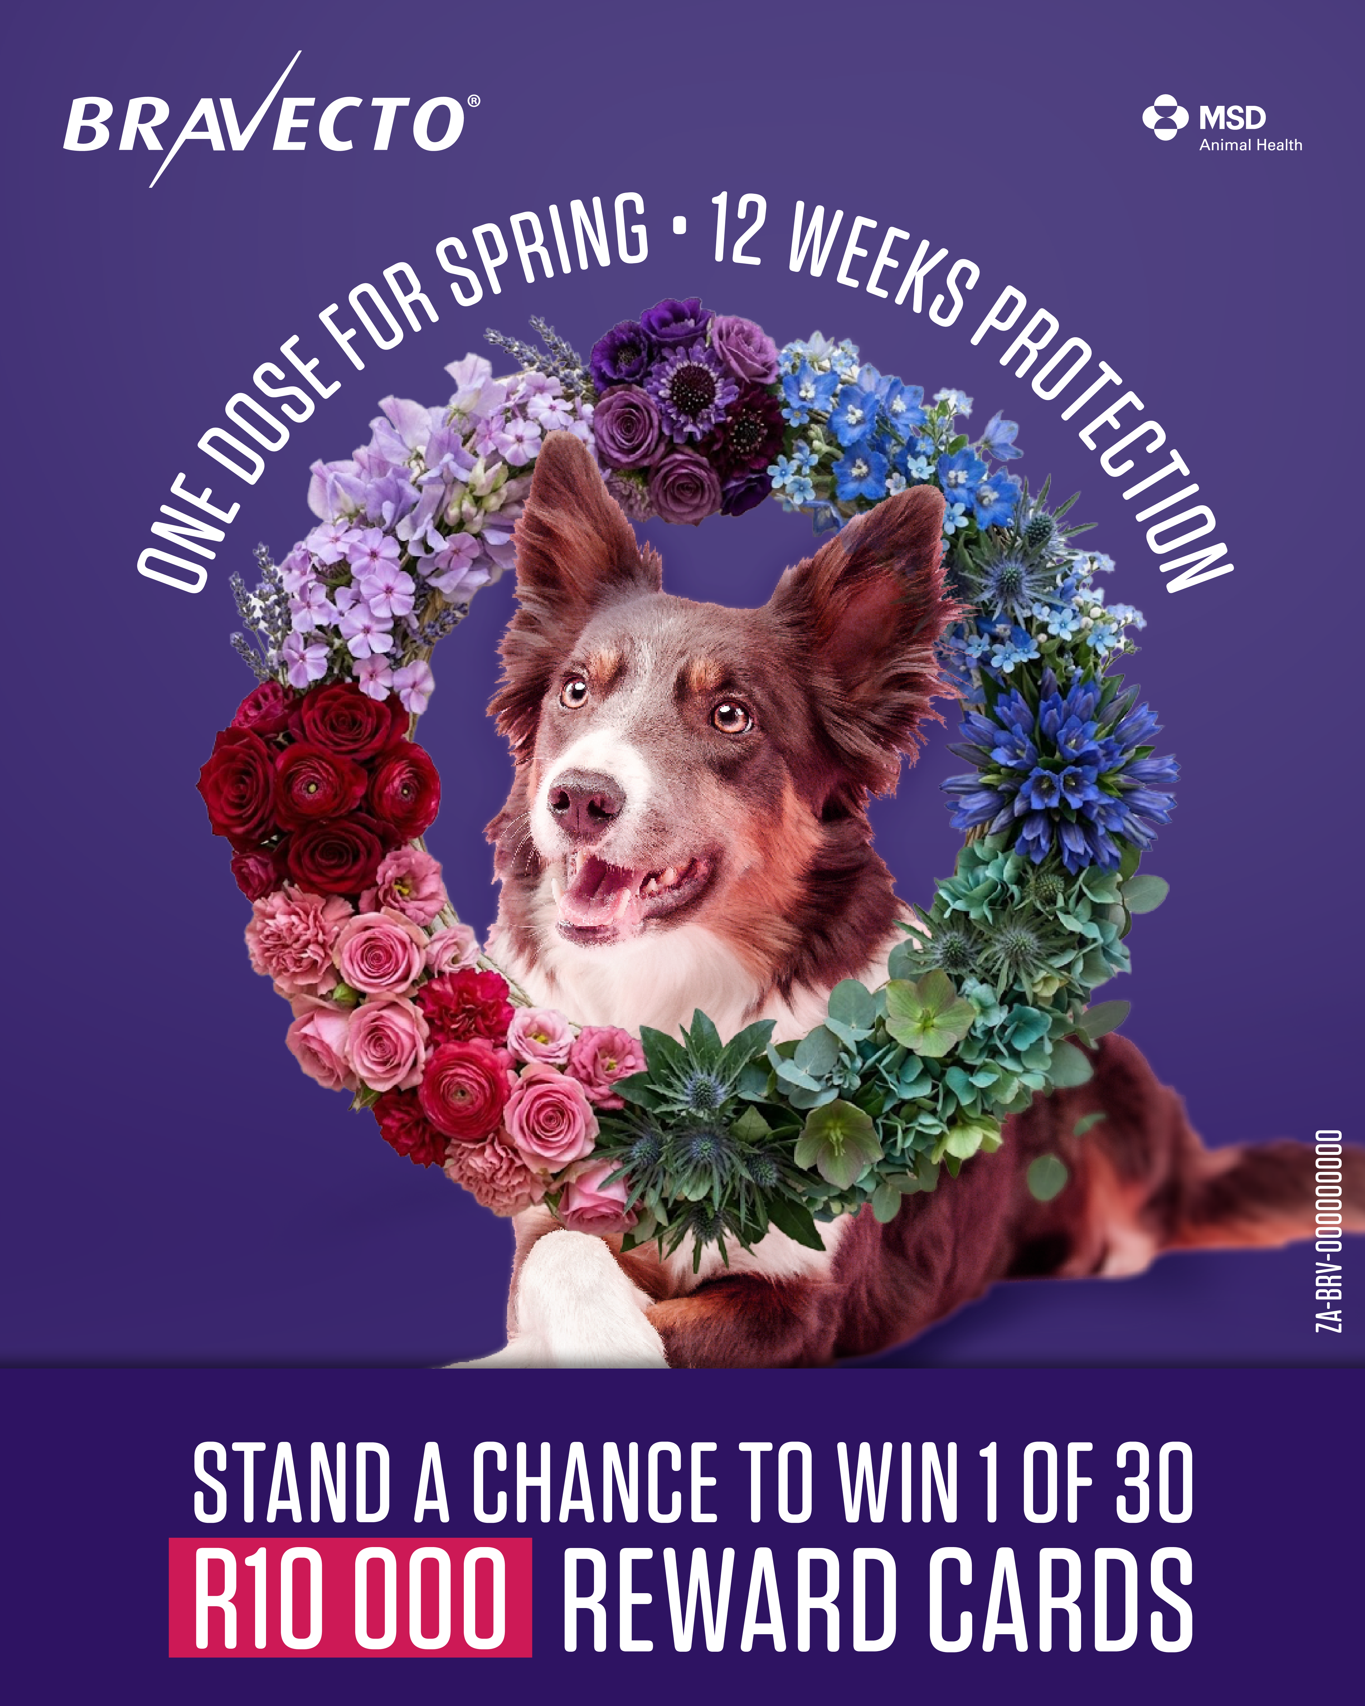
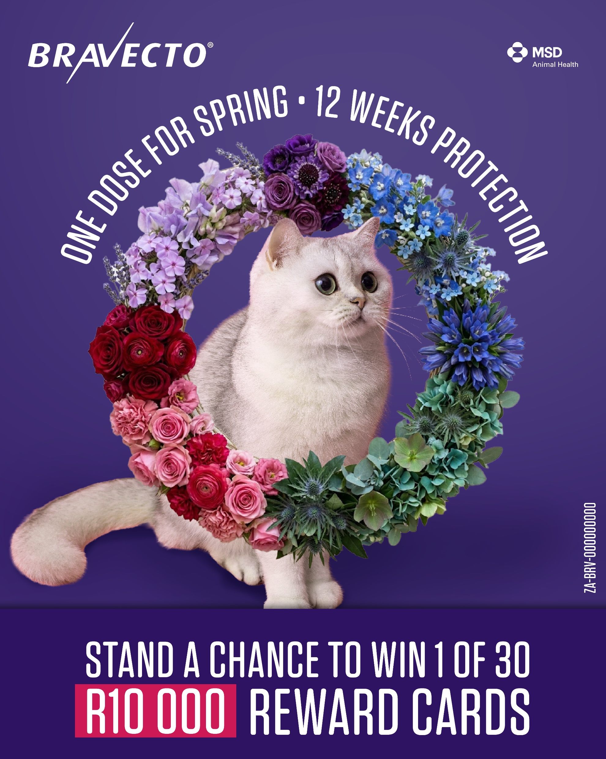
Spring Promotion 2026 | Meta Assets: Image Ads - Competition
Bravecto®
Keep your dog protected all season with Bravecto®. One dose gives you peace of mind that your pets are protected against ticks and ﬂeas for 12 weeks.
Keep your cat protected all season with Bravecto®. One dose gives you peace of mind that your pets are protected against ticks and ﬂeas for 3 months.

Slide 7
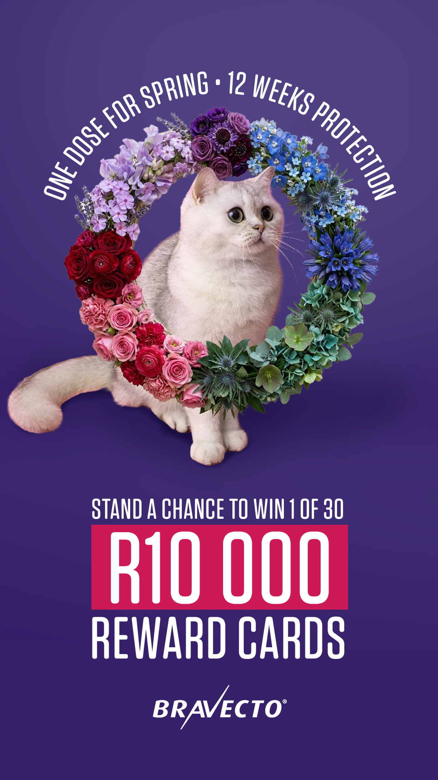
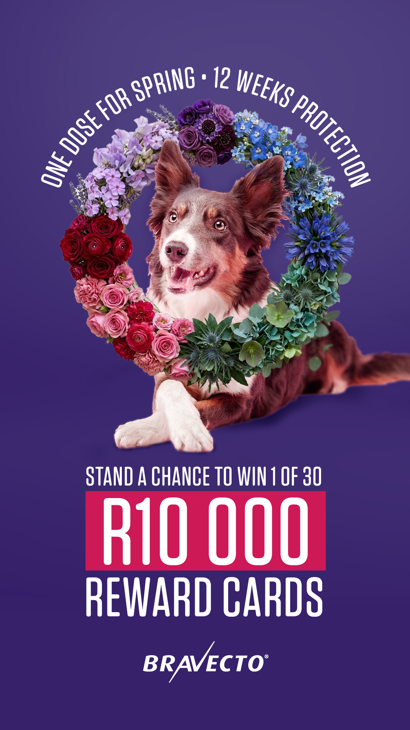
Spring Promotion 2026 | Meta Assets: Stories (Static) - Competition
Bravecto®

